Slide 1
ICS4 – Project Management
Development Models

Slide 2
Software Development Models
Project
“A temporary endeavor undertaken to create a unique product, service or result”
PMBOK Guide (2004), PMI, p. 5
Project Management
“The application of knowledge, skills, tools, and techniques to project activities to meet project requirements”
PMBOK Guide (2004), PMI, p. 16

Slide 3

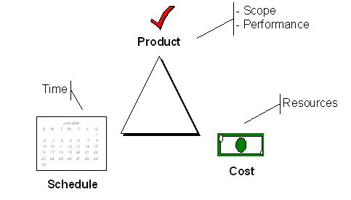
Scope, time, cost – may be fixed or variable
All relate to product and project quality

Slide 4
Software Development Models
SDLC – Software Design Lifecycle
There are numerous software development models used in industry and many are variations on two core models
Traditional Waterfall Model
Iterative Model – Extreme Programming

Slide 5
Software Development Models
Traditional Waterfall Model
Requirements
Each step is sequential.
Ideally process never steps backwards.
Design
Implement
Test
Maintenance

Slide 6
Software Development Models
Extreme Programming (Iterative, Spiral or Agile)
Characterized by a series of product prototyping and customer validation before continued development.
Anticipates the changing requirements of the customer.
Form of risk management to ensure product does not get off track.
Increased development cost?

Slide 7
Software Development Models
Extreme Programming

Slide 8
Software Development Models
STRENGTHS
Waterfall
Extreme
Allows for work force specialization
X
X
Orderliness appeals to management
X
?
Can be reported about
X
X
Facilitates allocation of resources
X
?
Early functionality
X
Does not require a complete set of requirements at the onset
X
Control costs and risk through prototyping
X

Slide 9
Software Development Models
WEAKNESSES
Waterfall
Extreme
Requires a complete set of requirements at the onset
X
Enforcement of non-implementation attitude hampers analyst/designer communications
X
Beginning with less defined general objectives may be uncomfortable for management
X
Incompatibility with a formal review and audit procedure
X
Tendency for difficult problems to be pushed to the future so that the initial promise of the first increment is not met by subsequent products
X

Slide 10
Software Development Models
References
http://en.wikipedia.org/wiki/List_of_software_development_philosophies
http://www.stsc.hill.af.mil/crosstalk/1995/01/Comparis.asp
http://www.extremeprogramming.org/
http://www.xprogramming.com/

